Slide 1
Songs analysis
In powerbi

Slide 2
Problem statement
This project aims to conduct a comprehensive analysis of YouTube songs data using Power BI.
The dataset contains key attributes such as video ID, channel title, title, description, tags, published date,
view count, like count, favorite count, comment count, video duration, video definition, and caption
details. The goal is to utilize Power BI to create insightful visualizations and reports that provide a deeper understanding of YouTube songs' performance, popularity, and user engagement. The analysis aims to
uncover trends, preferences, and patterns in the data to aid content creators and stakeholders in
optimizing their YouTube song content.

Slide 3
Project Objectives:
Data Cleaning and Preparation
Exploratory Data Analysis (EDA)
Content and Channel Analysis
Temporal Trends
User Engagement Insights

Slide 4
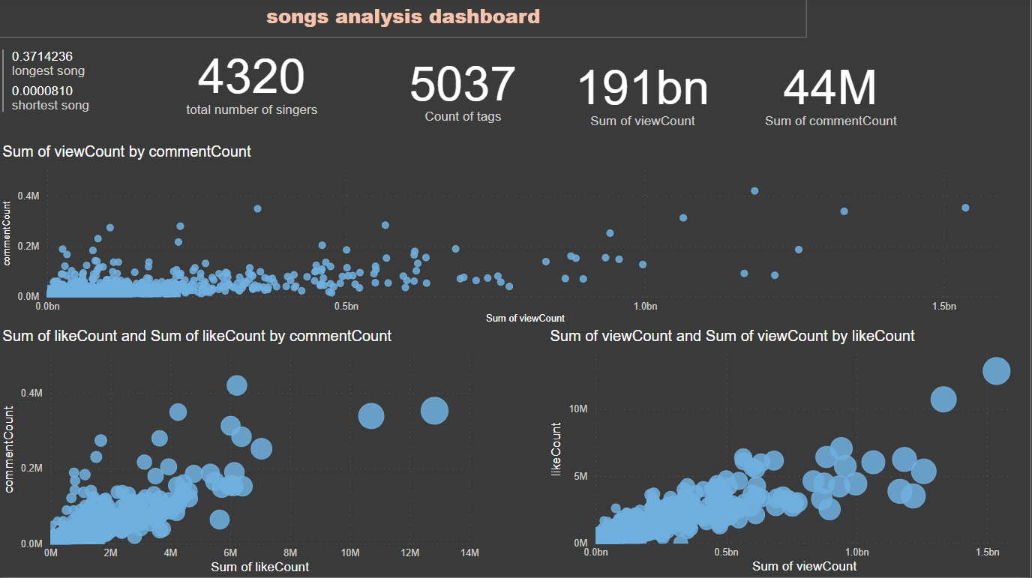
Exploring data

Slide 5
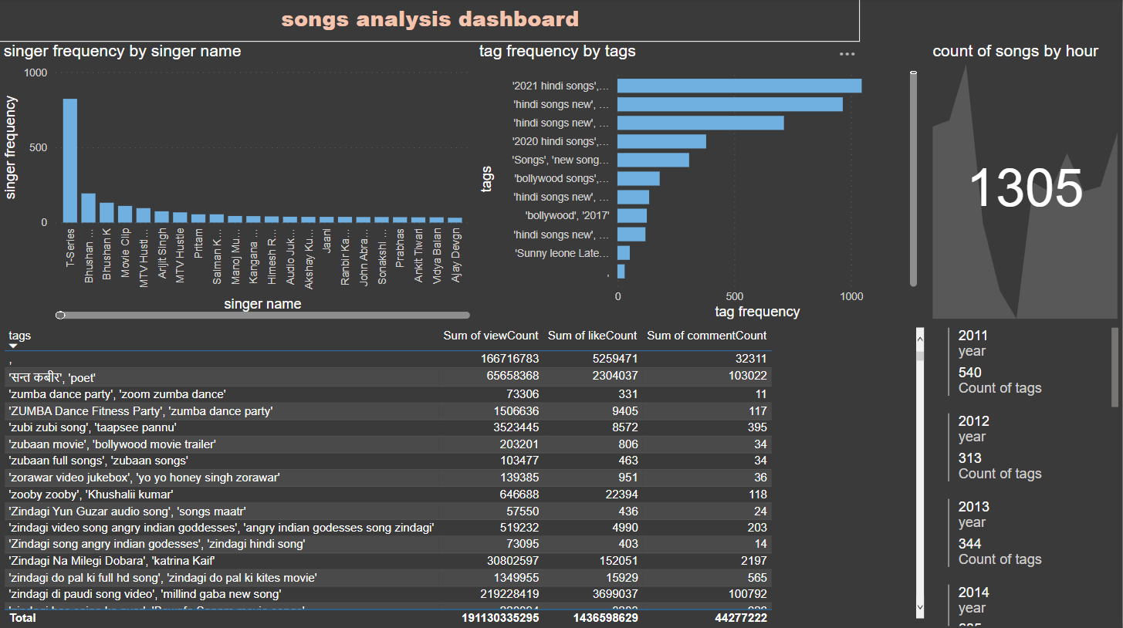
Trends

Slide 6
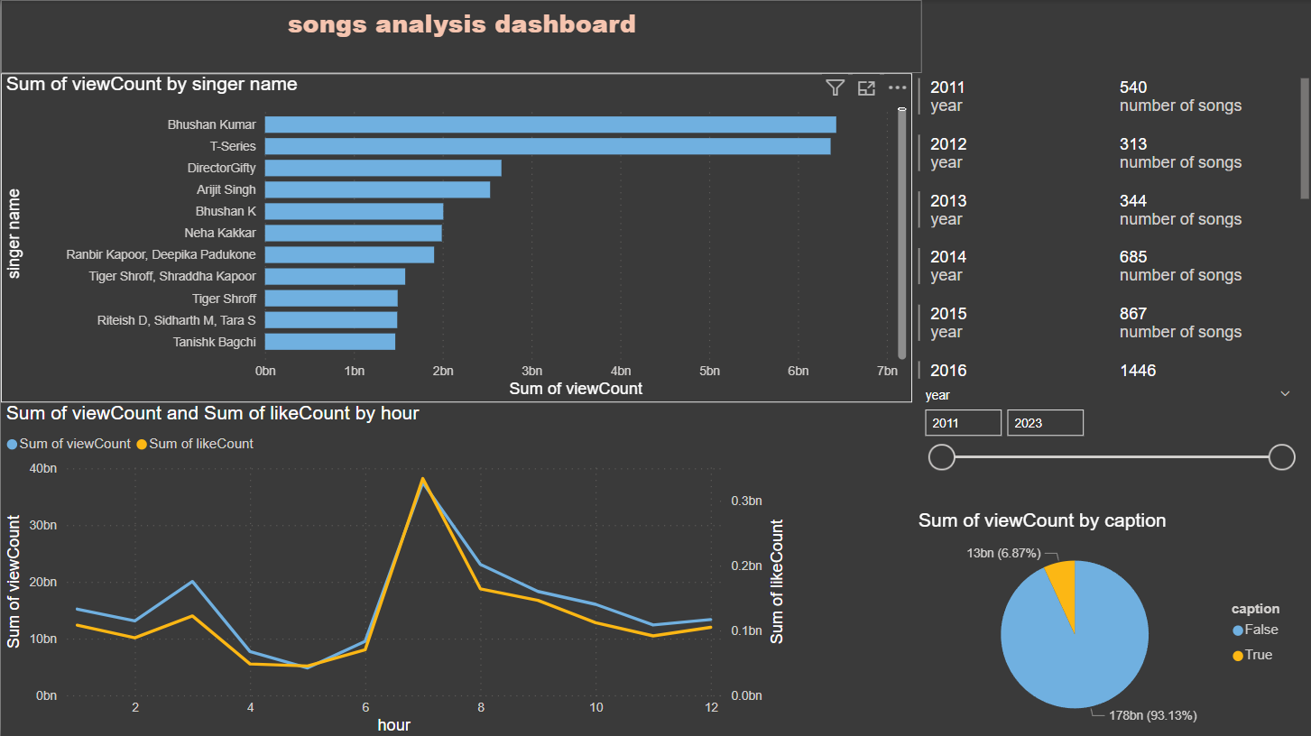
recommendations

Slide 7
Recommendations and trends
1- views differ between different singers as there are some singers who have high view rates
2- the best time for publishing songs is 7 clock.
3- its better to make songs without caption.
4- there is powerful relationship between views, likes and comments.

